Slide 1
JavaScript for Web Warriors, 7e Chapter 8: Creating Customized Objects, Properties, and Methods

Slide 2
Chapter Objectives (1 of 2)
By the end of this chapter, you should be able to:
Describe the fundamentals of object-oriented programming.
Create an object literal.
Define a method for a customized object.
Apply a method to an object class using a prototype.
Notes:
Instructions: Briefly review with students the major concepts you will be covering during this class. There is one objective for every major A-head section of the chapter.

Slide 3
Chapter Objectives (2 of 2)
By the end of this chapter, you should be able to:
Create and apply a closure.
Work with public, private, and privileged methods.
Create a prototype chain to combine objects.
Work with associative arrays to store data in JSON format.
Notes:
Instructions: Briefly review with students the major concepts you will be covering during this class. There is one objective for every major A-head section of the chapter.

Slide 4
Understanding Object-Oriented Programming (1 of 3)
Reusing software objects
Object-oriented programming (OOP): the creation of reusable software objects that can be easily incorporated into multiple programs
Code and data written into objects can be treated as an individual unit and reused in a wide variety of contexts
Three types of objects:
Native objects: objects that are part of the JavaScript language
Host objects: objects provided by the browser (e.g., Window, Document, Form)
Custom objects (user-defined objects): objects created by the user for specific programming tasks
Objects from different sources are combined to create a finished application

Slide 5
Understanding Object-Oriented Programming (2 of 3)
Understanding encapsulation
Encapsulation: process by which all code (primarily properties and methods) and data needed for the object are completely contained within the object itself
The object's inner workings are accessed through an interface, which consists of methods and properties that other program components can work with
Sample project for this chapter is to create objects for an online card game to represent:
A single playing card
A draw poker hand (i.e., a player's current cards)
A deck of cards
A game of draw poker
In the online game, the player (user) is given a "bank" from which to bet money plus a hand of cards, and chooses whether to draw one or more cards to replace the ones in the hand before their hand is evaluated

Slide 6
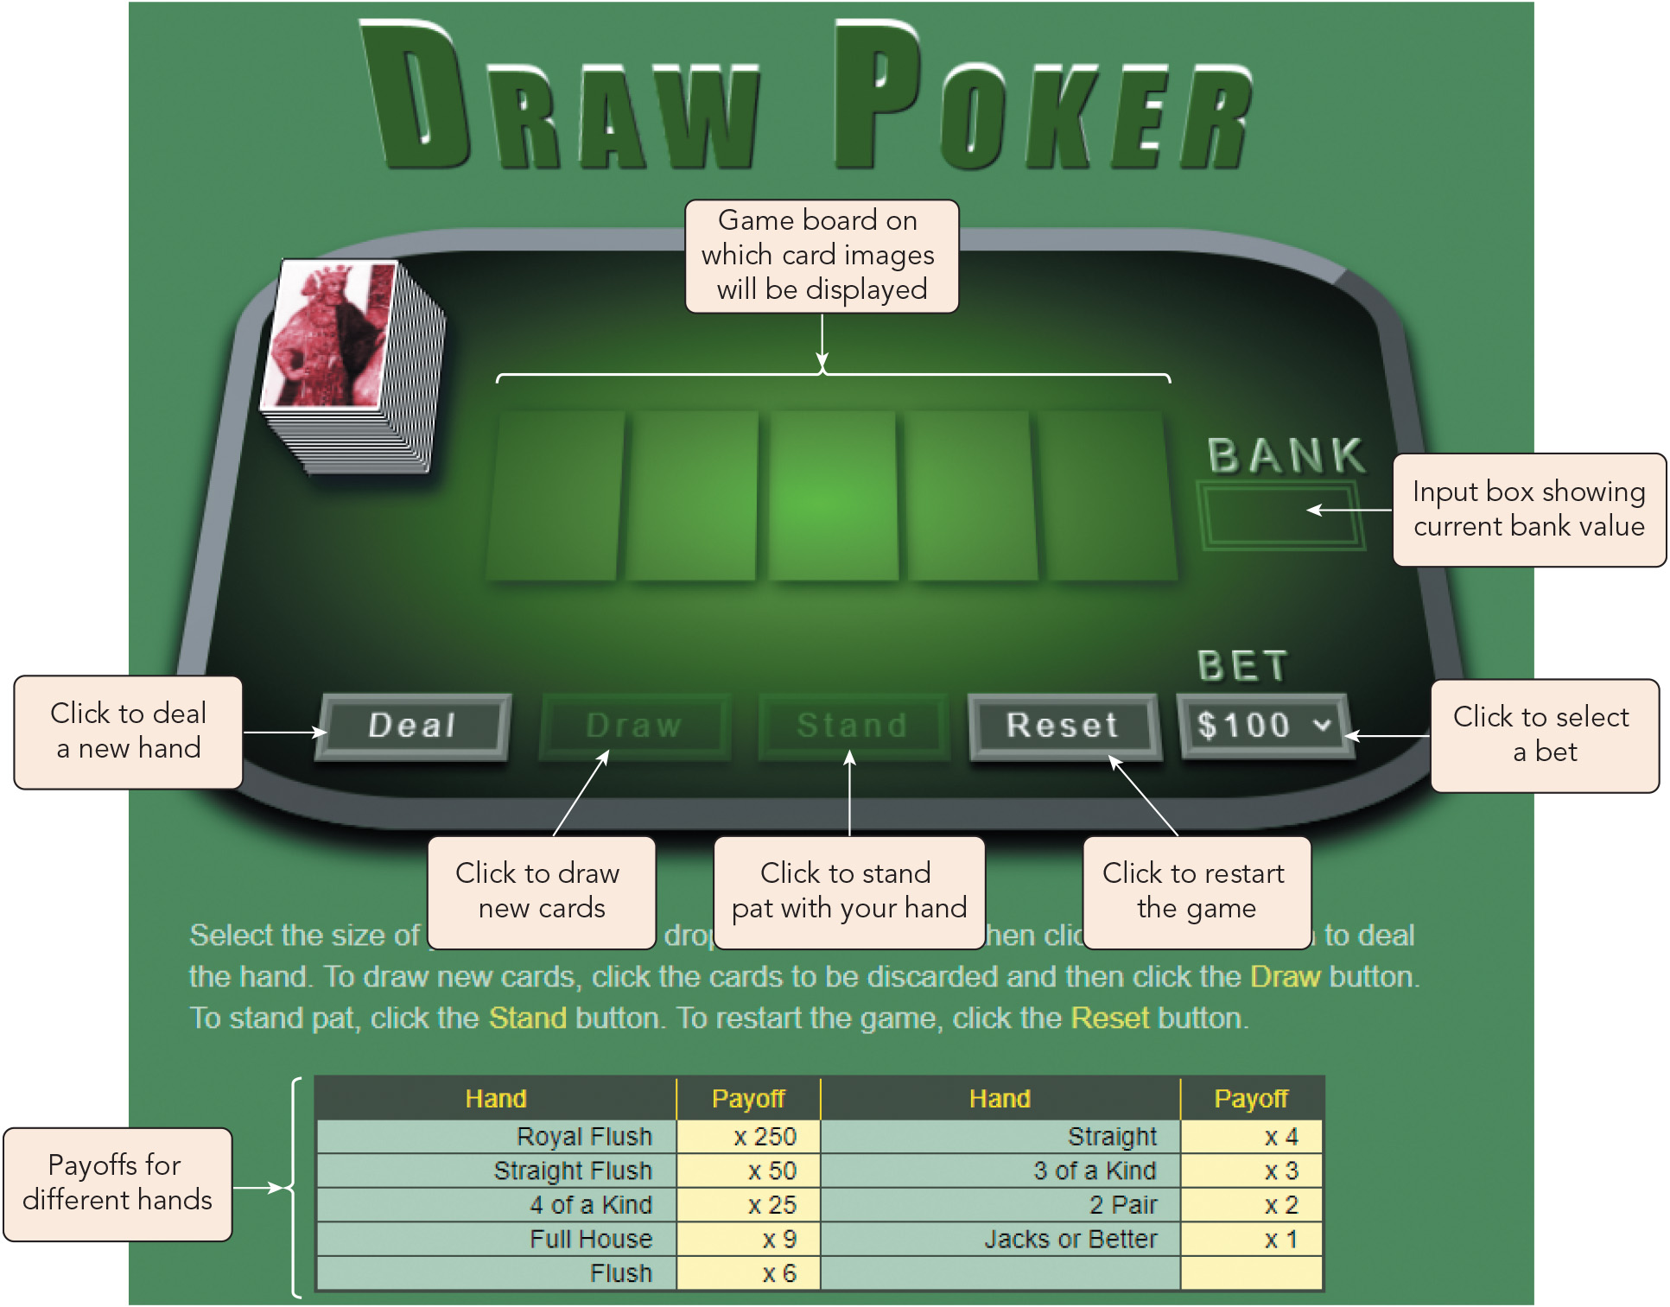
Understanding Object-Oriented Programming (3 of 3)
Figure 8-2 Starting Draw Poker page

Slide 7
Creating an Object Literal (1 of 8)
Object literal: a standalone object used once for a single purpose
One object literal can be nested within another as a property of the outer object
Syntax for defining an object literal: let objName = { name1: value1, name2: value2, ... };
Sample object literal: let cardGame = { title: "Draw Poker", createdBy: "Ronnell Jones", lastRevised: null, programmers: ["Tom Devlan", "Chanda Bhasin"] };

Slide 8
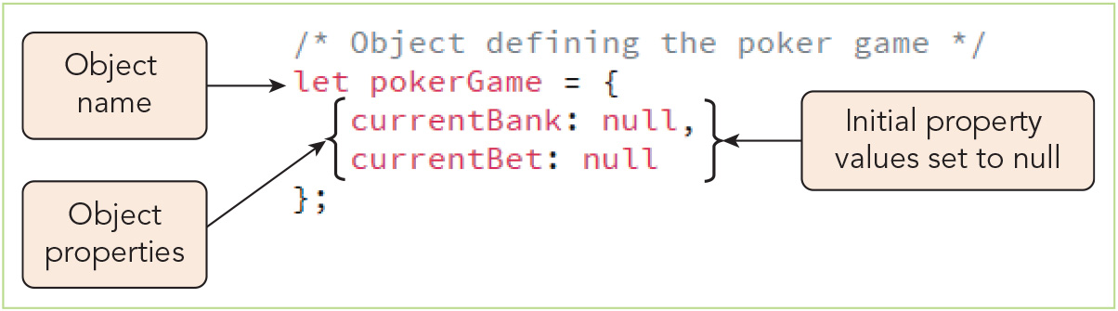
Creating an Object Literal (2 of 8)
Figure 8-3 Creating the pokerGame object literal

Slide 9
Creating an Object Literal (3 of 8)
Dot operators and bracket notation
Syntax for accessing an object property with a dot operator: object.property
Syntax for accessing an object property using bracket notation: object["property"]
When bracket notation is used, the property name can be referenced as a variable, e.g.: let employee = { name: "Ronnell Jones", position: "manager" }; let prop = "name"; window.alert(employee[prop]);
Either notation can be used with custom or built-in objects depending on the needs of your code

Slide 10
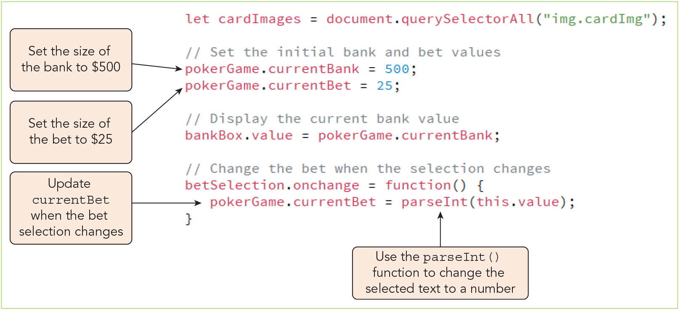
Creating an Object Literal (4 of 8)
Figure 8-4 Setting values for currentBank and currentBet

Slide 11
Creating an Object Literal (5 of 8)
Creating a custom method
General syntax for adding a method to an object literal, where method is the method name: let objName = { method: function() { commands } };
Methods use the this keyword to reference the current object, in this case the object itself
Custom methods are called the same way as methods for built-in objects

Slide 12
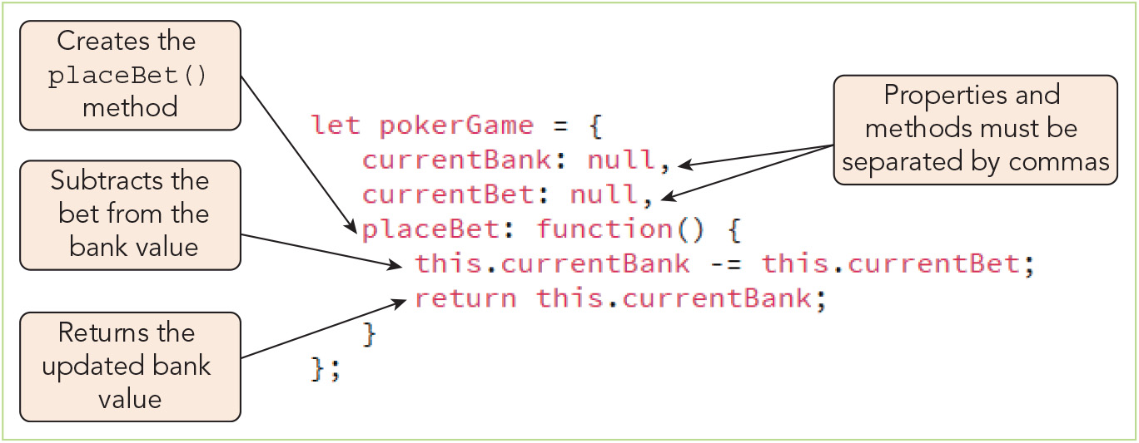
Creating an Object Literal (6 of 8)
Figure 8-5 Creating the placeBet() method

Slide 13
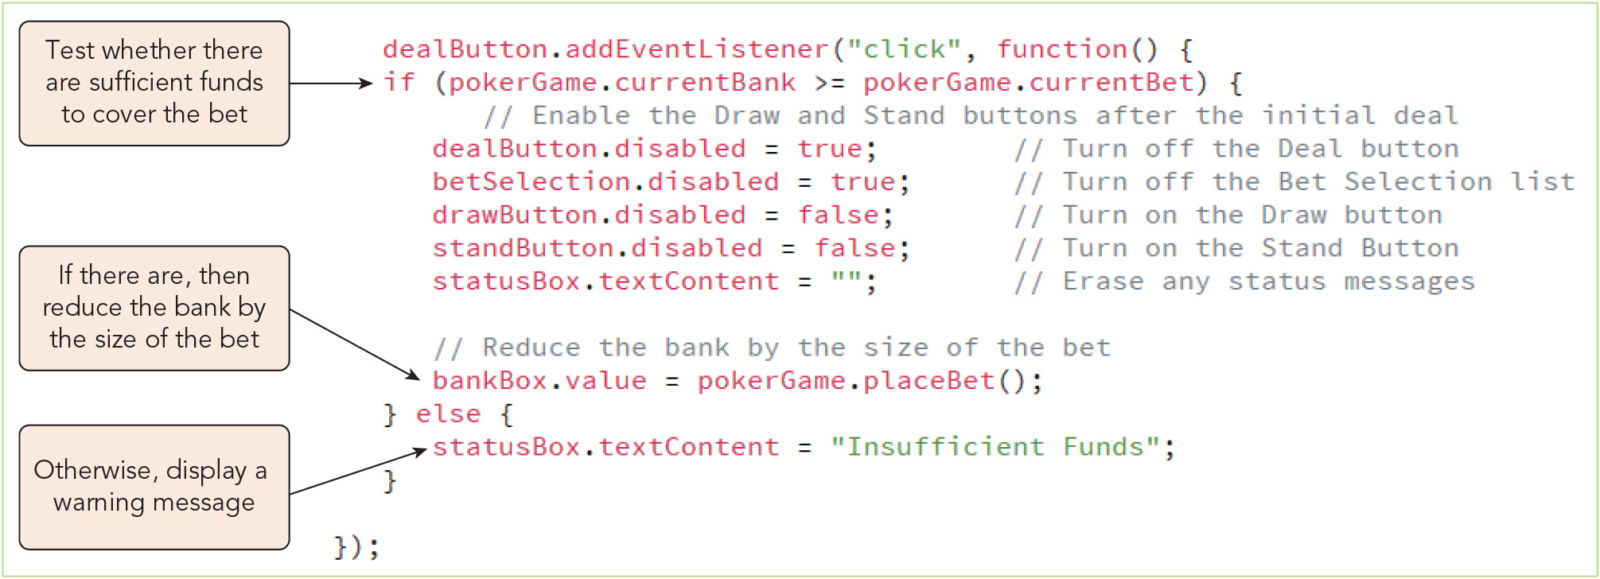
Creating an Object Literal (7 of 8)
Figure 8-6 Applying the placeBet() method

Slide 14
Creating an Object Literal (8 of 8)
Creating an object with the new operator
Alternate syntax for creating an object literal using the Object() command: let objName = new Object(); objName.property = value; objName.method = function() { commands };
Sample code defining an object literal using the new Object() operator: let pokerGame = new Object(); pokerGame.currentBank = null; pokerGame.currentBet = null; pokerGame.placeBet = function() { this.currentBank -= this.currentBet; return this.currentBank; };

Slide 15
Working with Object Classes (1 of 10)
Understanding object classes
An object class acts as a template or blueprint for the creation of new objects all sharing a common collection of properties and methods
Each of these new objects is an object instance produced by instantiating a class
Object constructors and literals
Syntax for an object constructor that instantiates objects: new Class(parameters)
Constructor functions
Syntax for a constructor function, which defines an object constructor: function Class(parameters) { this.prop1 = value1; this.prop2 = value2; … this.method1 = function1; this.method2 = function2; … }

Slide 16
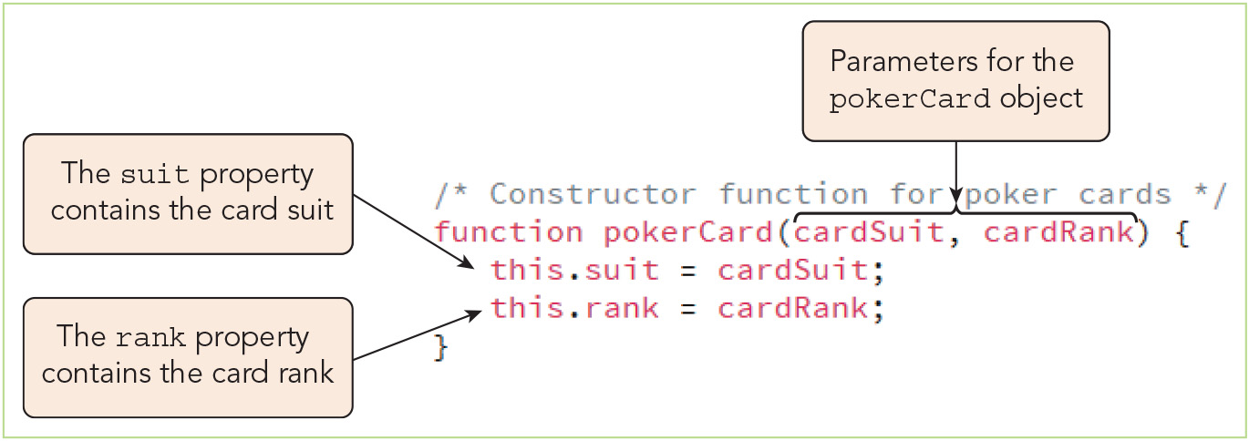
Working with Object Classes (2 of 10)
Figure 8-8 Creating the pokerCard object class

Slide 17
Working with Object Classes (3 of 10)
Combining object classes
An object can include objects defined in other classes
For the poker game project, a nested for loop is used to create an array of 52 pokerCard objects that serves as the value for the cards property of the pokerDeck object class
A shuffle() method is added to the pokerDeck object class to randomize the order of pokerCard objects in the cards array
A pokerHand object class is created
A dealTo() method that removes items from the pokerDeck.cards array and assigns them as an array value to the pokerHand.cards property is added to the pokerDeck object class

Slide 18
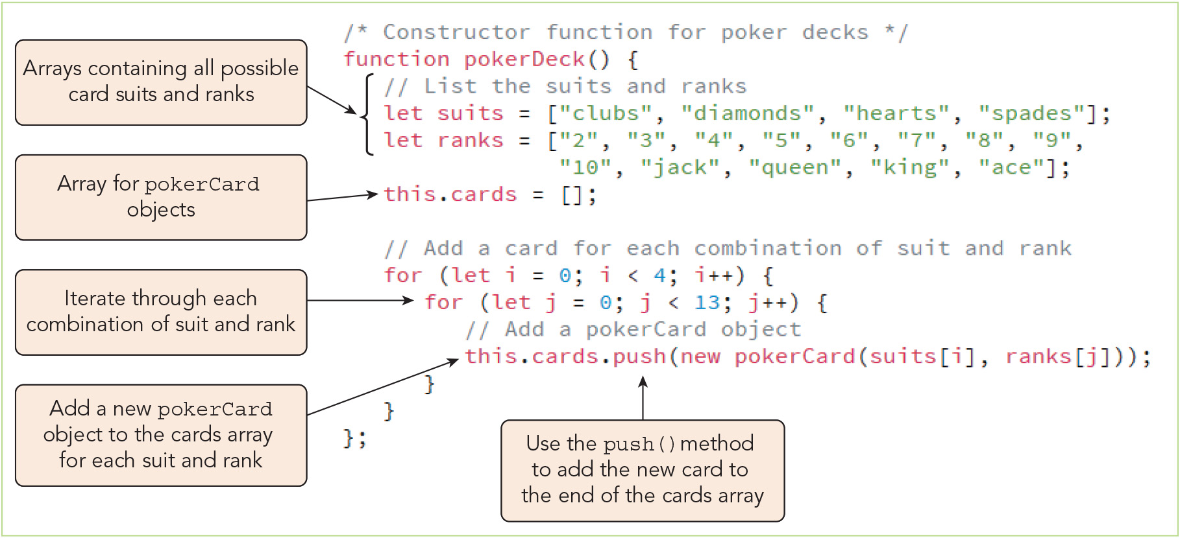
Working with Object Classes (4 of 10)
Figure 8-9 Creating the pokerDeck object class

Slide 19
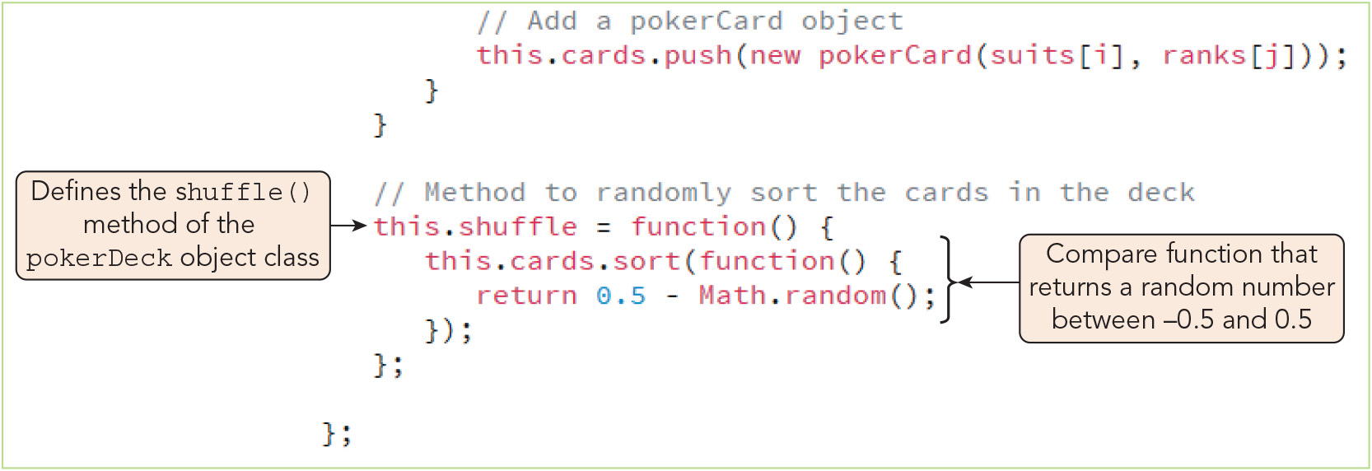
Working with Object Classes (5 of 10)
Figure 8-10 Creating the shuffle() method

Slide 20
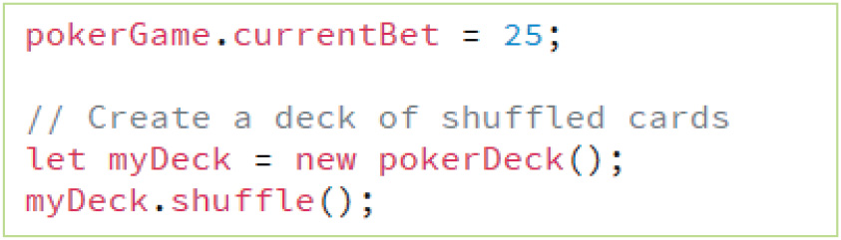
Working with Object Classes (6 of 10)
Figure 8-11 Creating an instance of the pokerDeck object class

Slide 21
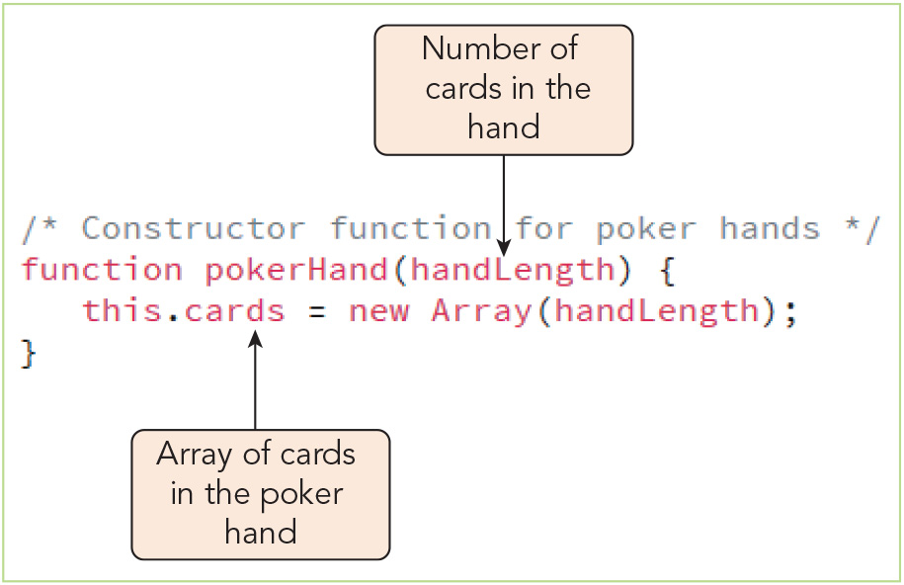
Working with Object Classes (7 of 10)
Figure 8-13 Creating the pokerHand() object class

Slide 22
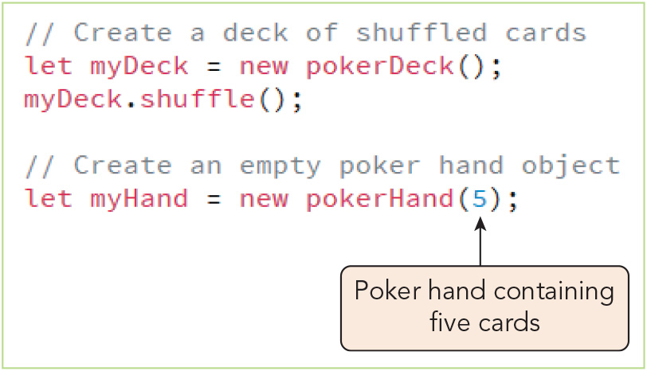
Working with Object Classes (8 of 10)
Figure 8-14 Instantiating a pokerHand() object

Slide 23
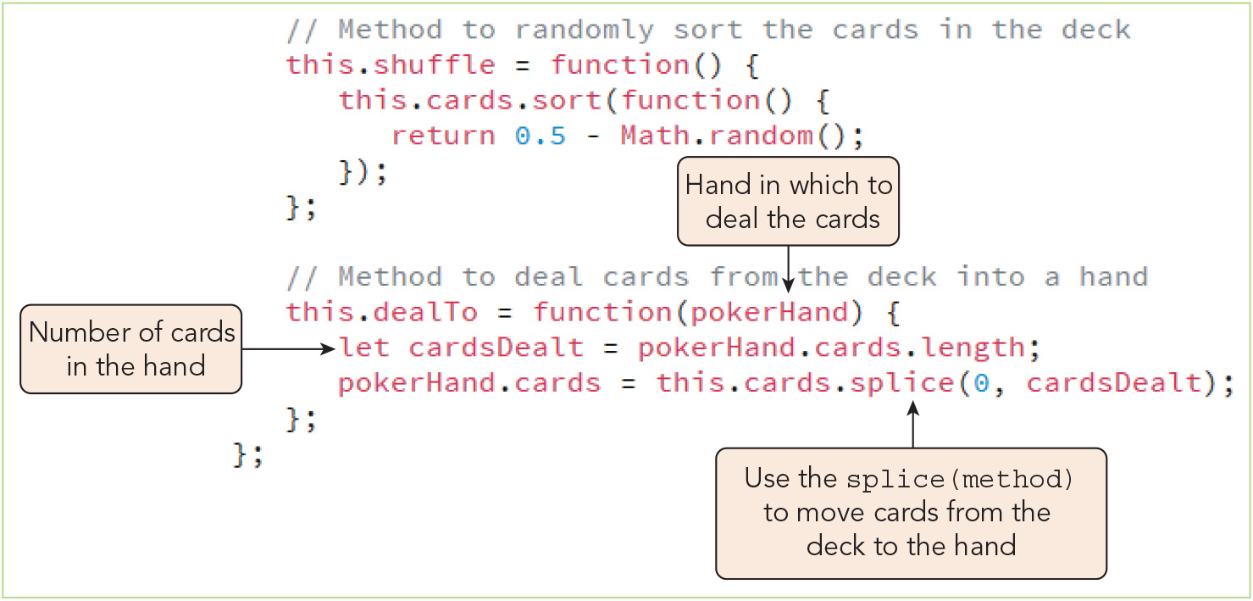
Working with Object Classes (9 of 10)
Figure 8-15 Creating the dealTo() method of the pokerDeck object class

Slide 24
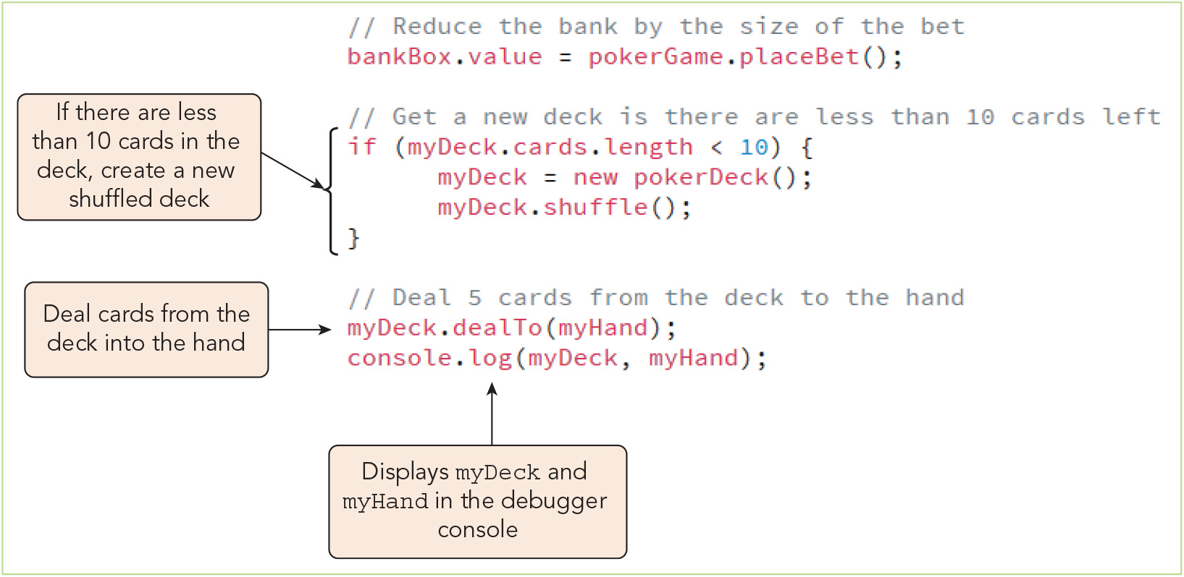
Working with Object Classes (10 of 10)
Figure 8-16 Dealing from the deck into a hand

Slide 25
Working with Object Prototypes (1 of 4)
Every object has a prototype—a template for all the properties and methods associated with the object's class
Placing code for object methods into the prototype makes them accessible to the constructor function
This is more resource- and memory-efficient than placing a method in the constructor function, where it will be copied into every object instance
The prototype object
Syntax for referencing the prototype: Class.prototype
Syntax for adding a method to a prototype: Class.prototype.method = function;
For the poker game project, the cardImage() method, which returns the file names of card images for each object instance, is added to the pokerCard prototype

Slide 26
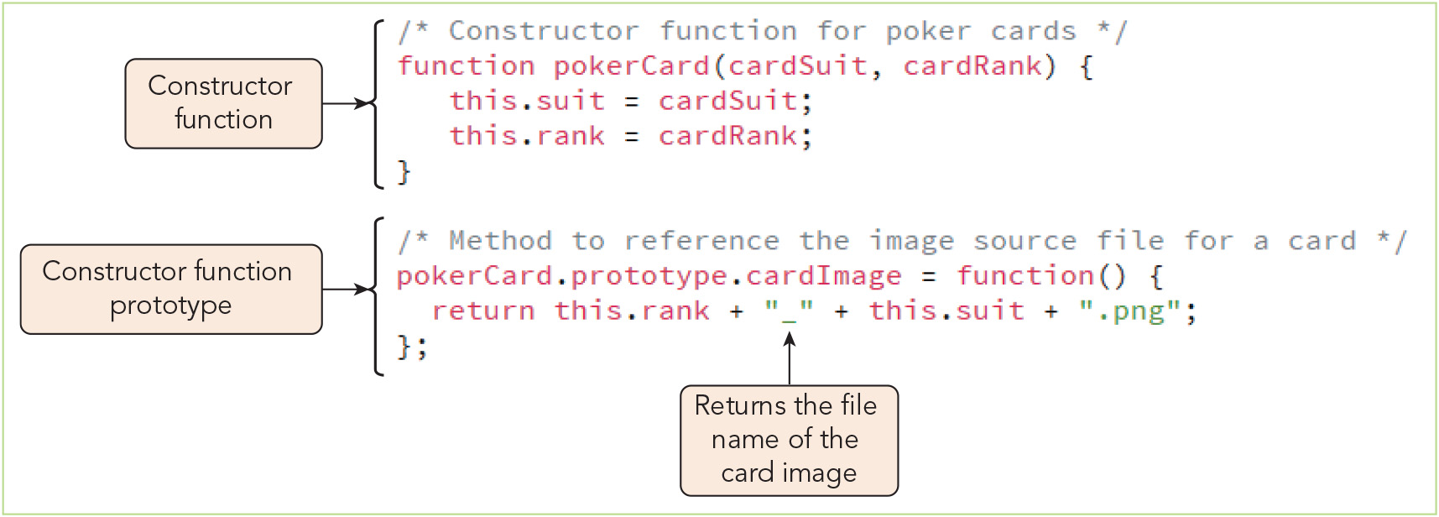
Working with Object Prototypes (2 of 4)
Figure 8-18 Creating the cardImage() method

Slide 27
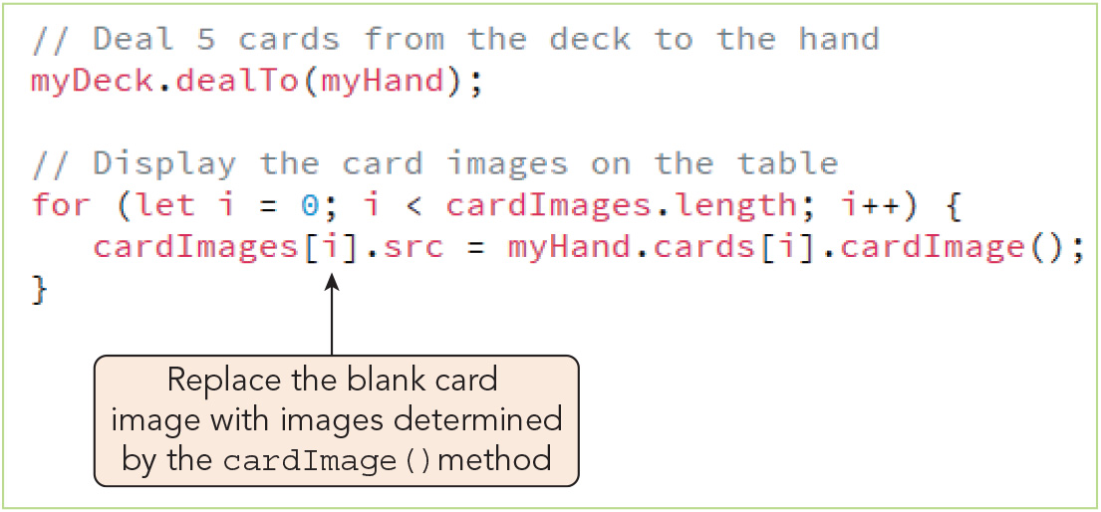
Working with Object Prototypes (3 of 4)
Figure 8-19 Displaying card images for a dealt hand

Slide 28
Working with Object Prototypes (4 of 4)
Extending built-in JavaScript objects
Native objects can be extended by the addition of new methods to their prototypes
Sample code to add a shuffle() method to the Array object's prototype: Array.prototype.shuffle = function() { this.sort(function() { return 0.5 – Math.random(); }); }
SOLID principles should be followed to enjoy the advantages of OOP
Single responsibility principle
Open/close principle
Liskov's substitution principle
Interface segregation principle
Dependency inversion principle

Slide 29
Activity 9.1: Knowledge Check
What does the following JavaScript code do? let candyDispenser = { candyInventory: null, dispenseCandy: function() { this.candyInventory -= 1; return this.candyInventory; } };
Rewrite the code in question 1 so that multiple "candy dispensers" can be efficiently generated within an application.
Notes:
Instructions:
Use the Knowledge Check questions to periodically pose a question to students during class to gauge how well they can recall the material that was presented.

Slide 30
Activity 8.1: Knowledge Check Answers (1 of 2)
What does the following JavaScript code do? let candyDispenser = { candyInventory: null, dispenseCandy: function() { this.candyInventory -= 1; return this.candyInventory; } }; This code creates an object literal called candyDispenser with a candyInventory property and a dispenseCandy() method that reduces the value of candyInventory by 1, then returns its new value.
Notes:
Instructions:
Use the Knowledge Check questions to periodically pose a question to students during class to gauge how well they can recall the material that was presented.

Slide 31
Activity 8.1: Knowledge Check Answers (2 of 2)
Rewrite the code in question 1 so that multiple "candy dispensers" can be efficiently generated within an application. To reuse the candyDispenser object efficiently, you can code it as an object class and add the method to its prototype rather than within its class constructor. function candyDispenser(candyInventory) { this.inventory = candyInventory; }; candyDispenser.prototype.dispenseCandy = function() { this.inventory -= 1; return this.inventory; }
Notes:
Instructions:
Use the Knowledge Check questions to periodically pose a question to students during class to gauge how well they can recall the material that was presented.

Slide 32
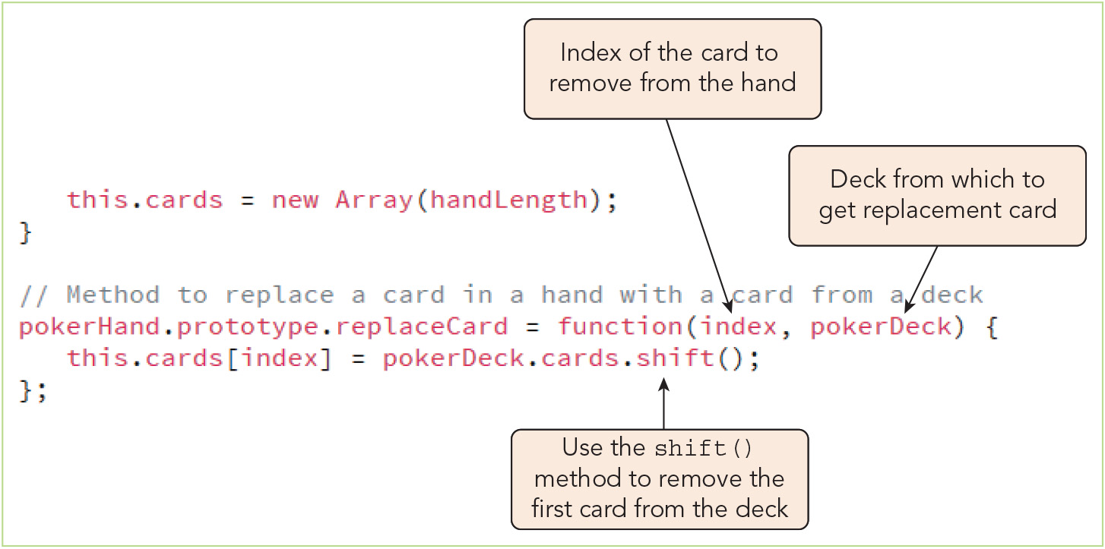
Introducing Closures (1 of 6)
Figure 8-21 Creating the replace() method of the pokerHand prototype

Slide 33
Introducing Closures (2 of 6)
Sample nested loop and its behavior: function outer() { let msg = "ace of spades"; function inner() { console.log(msg); } inner(); console.log("is my card"); } // run the outer() function // outer(); // logs "ace of spades" // logs "is my card"
Lexical scope
In the sample nested loop, the inner() function "knows" the msg variable because of lexical scope (a.k.a. static scope)
Lexical scope is based on the physical location of variables, functions, and other objects in the source code
Lexical environment: environment that encompasses functions and the variables they use, in which they are interpreted

Slide 34
Introducing Closures (3 of 6)
Sample nested loop where the outer function returns the inner function: function outer() { let msg = "ace of spades"; function inner() { console.log(msg); } return inner; console.log("is my card"); } let myClosure = outer(); myClosure(); // logs "ace of spades"
Closures and the lexical environment
When the inner() function is stored in the myClosure variable, a closure is created in which the lexical environment is copied, too
Closures "enclose" everything about the function, including its context within the surrounding source code
Functions that create closures require more memory

Slide 35
Introducing Closures (4 of 6)
Functions as objects and variables
Functions have properties, including name, caller, and length (number of arguments)
Dynamic functions whose properties and methods are themselves variables can be created with the new Function() object constructor
Closures with for loops
Closures appear with program loops that call functions at each iteration
The value of the i counter variable at the time it is referenced within the loop is retained for component functions/methods run after the loop finishes
Closures appear in program loops involving event handlers that are not run until the event occurs
Again, the value of the i counter variable at the time the loop runs is used when the associated event handler is run
The poker game uses this feature to generate event handlers to "flip the cards"

Slide 36
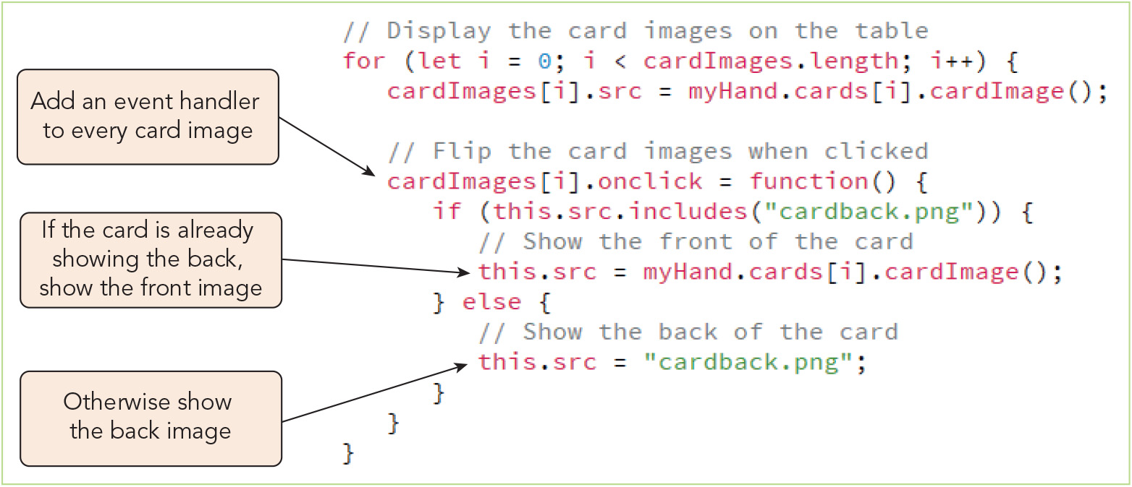
Introducing Closures (5 of 6)
Figure 8-22 Switching the card images between the back and front

Slide 37
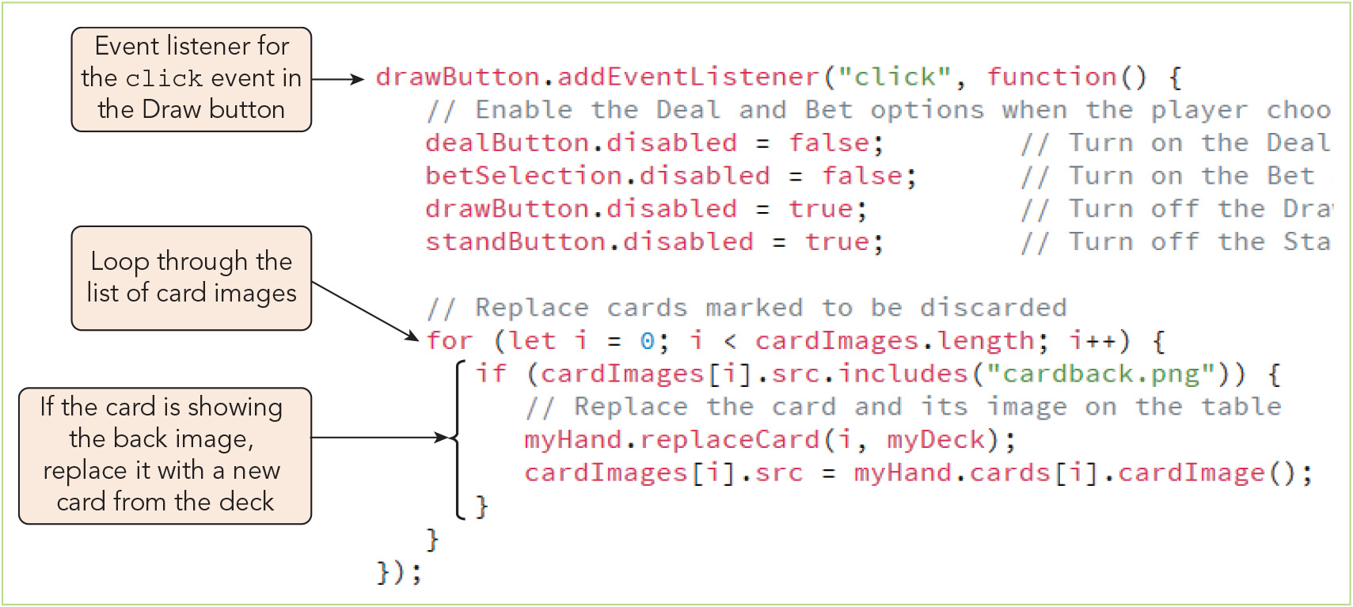
Introducing Closures (6 of 6)
Figure 8-24 Replacing marked cards when the Draw button is clicked

Slide 38
Working with Public, Private, and Privileged Methods (1 of 6)
Methods associated with custom objects can be public, private, or privileged
Public method: a method that is defined for the object prototype and, thus, can be called outside of the object
Private method: a method that is created within the constructor function and, thus, accessible only within the constructor
Protects code from being changed, but must be copied with each instantiation
Privileged method: a method that accesses private variables and methods but that is also accessible to the public
Private and privileged methods can be created only within the constructor function
Public methods can be created at any time using the object's prototype
A public getHandValue() method and a private handType() method are added to the pokerHand prototype for the poker game project

Slide 39
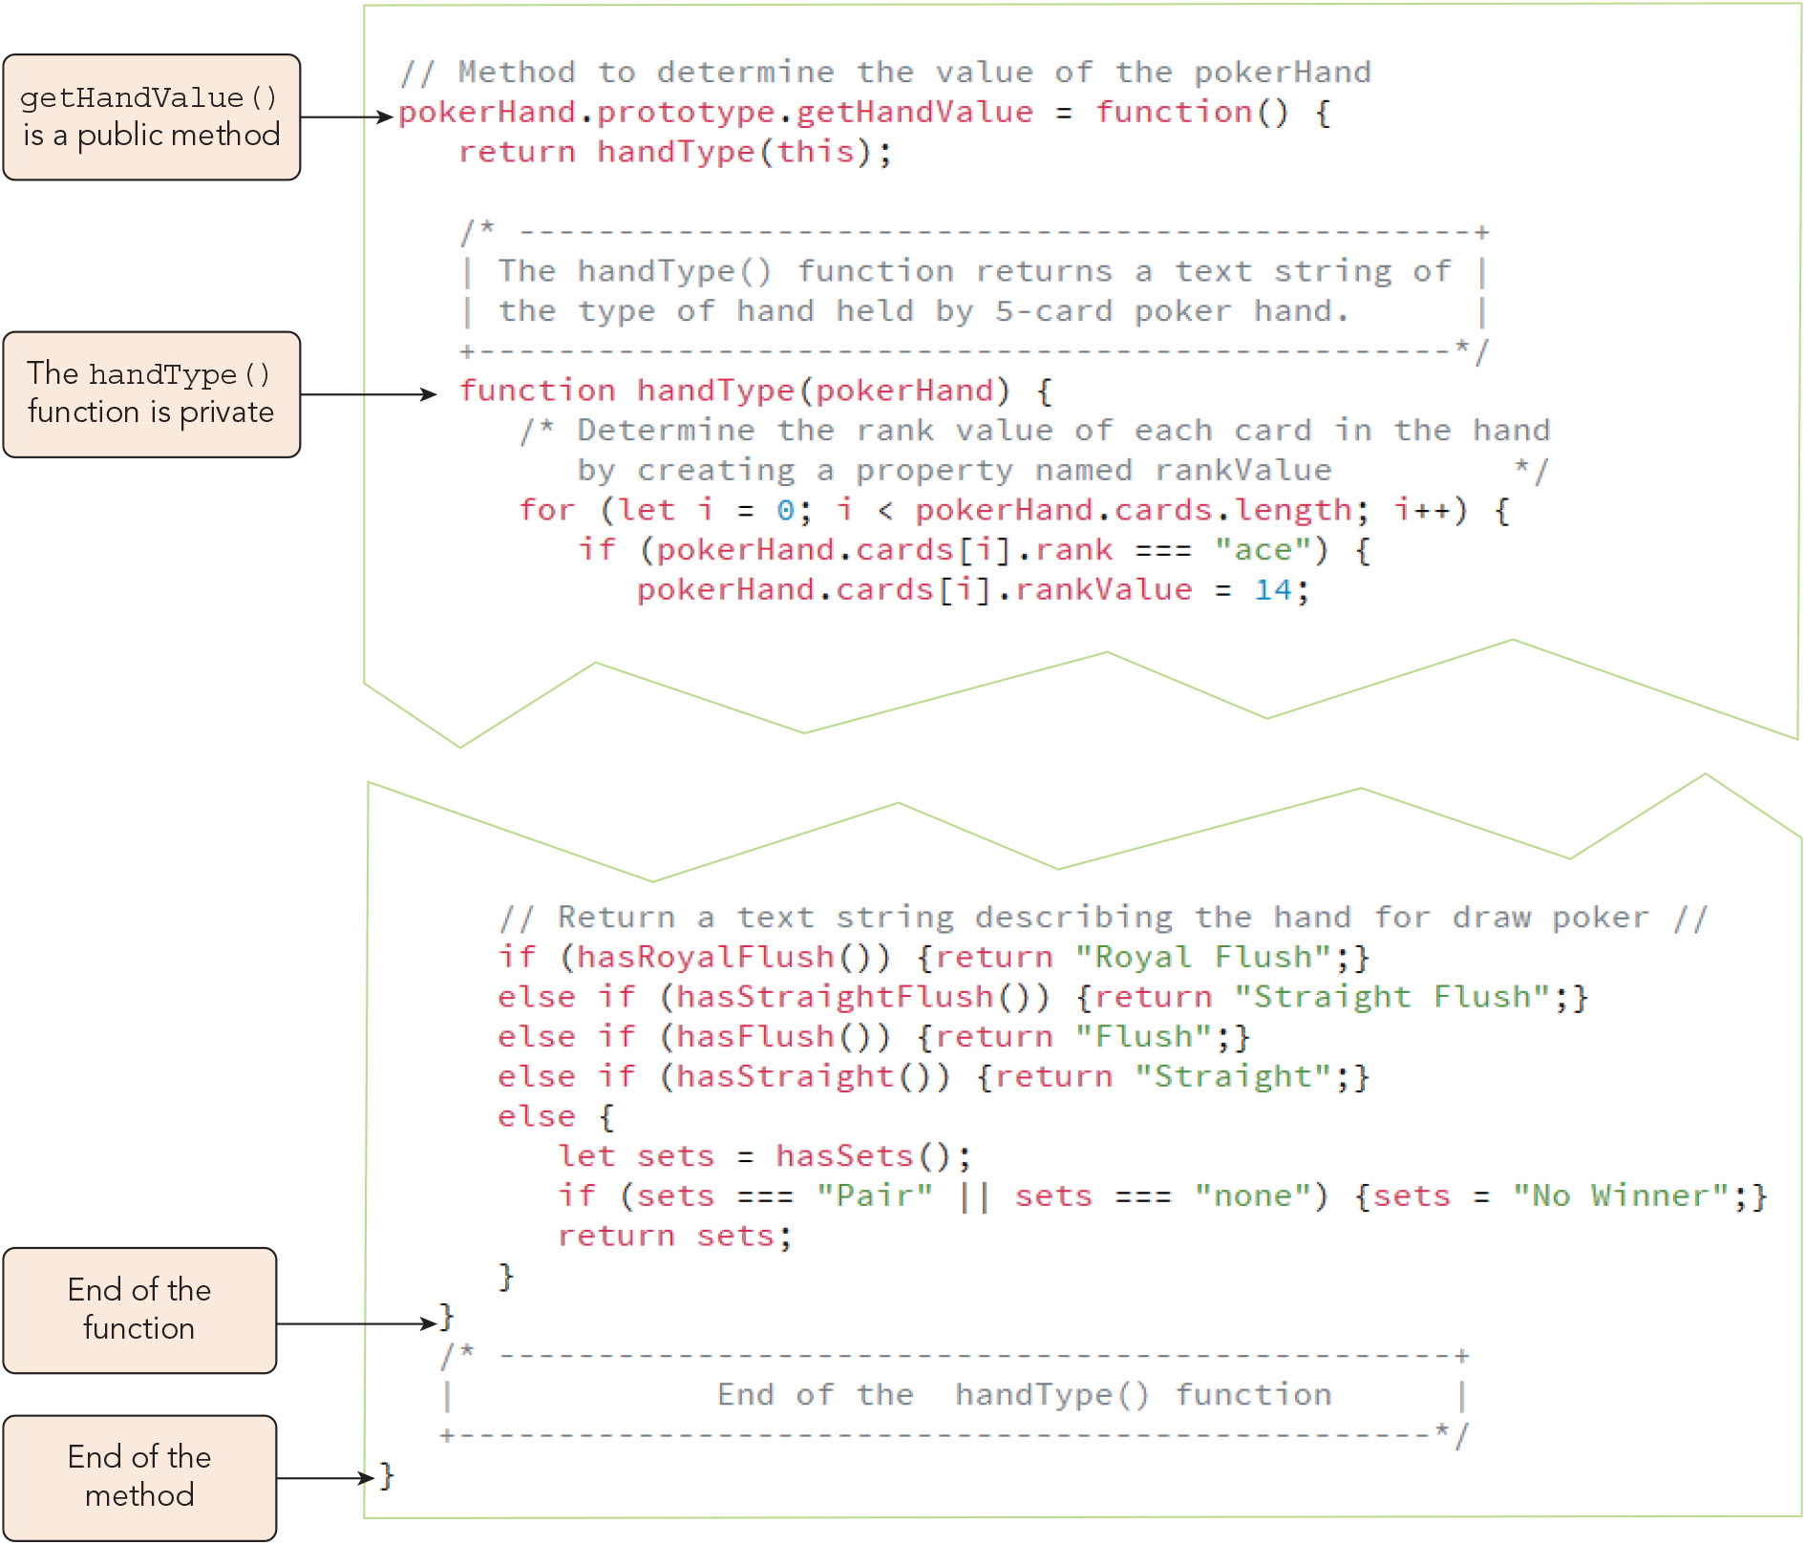
Working with Public, Private, and Privileged Methods (2 of 6)
Figure 8-26 Adding the getHandValue() public method

Slide 40
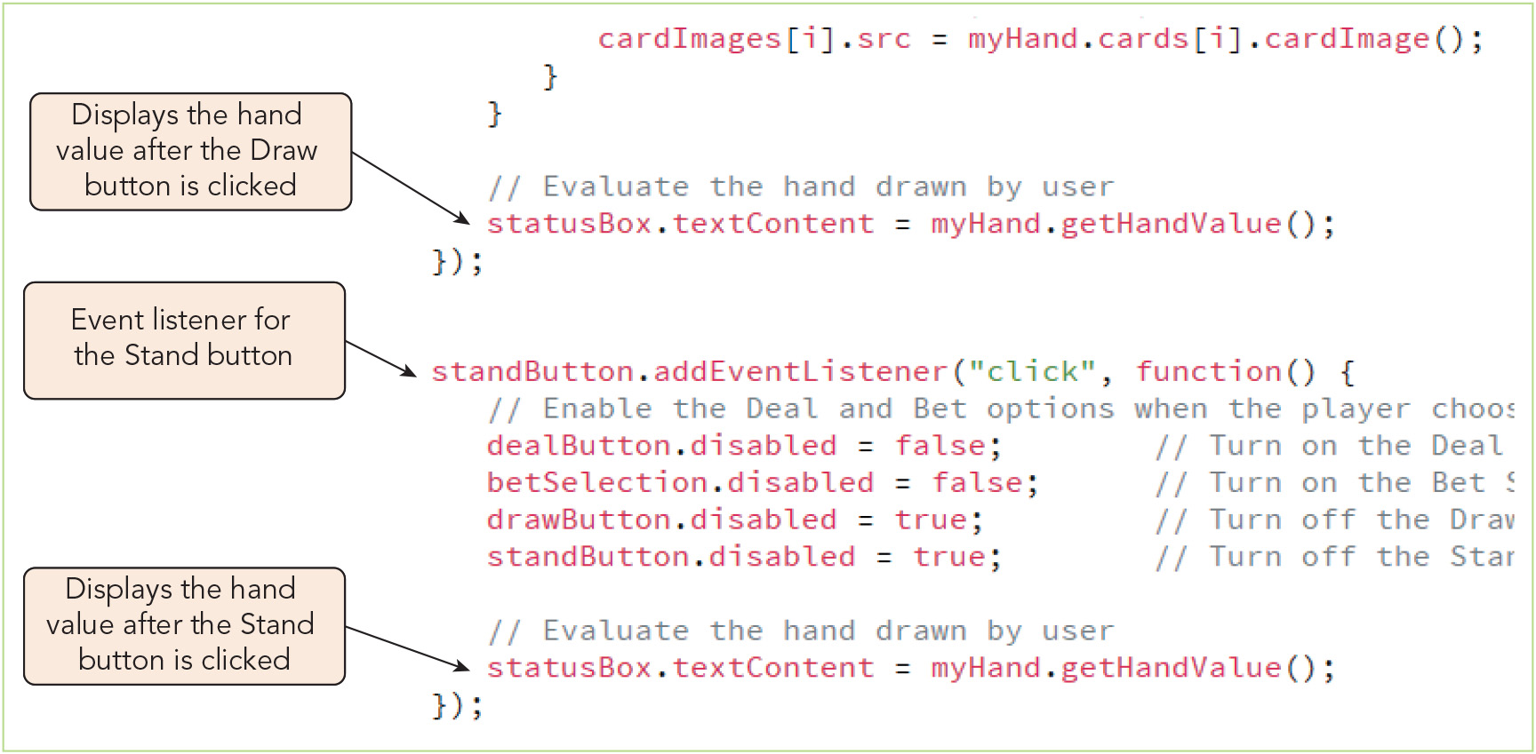
Working with Public, Private, and Privileged Methods (3 of 6)
Figure 8-27 Displaying the value of the played hand

Slide 41
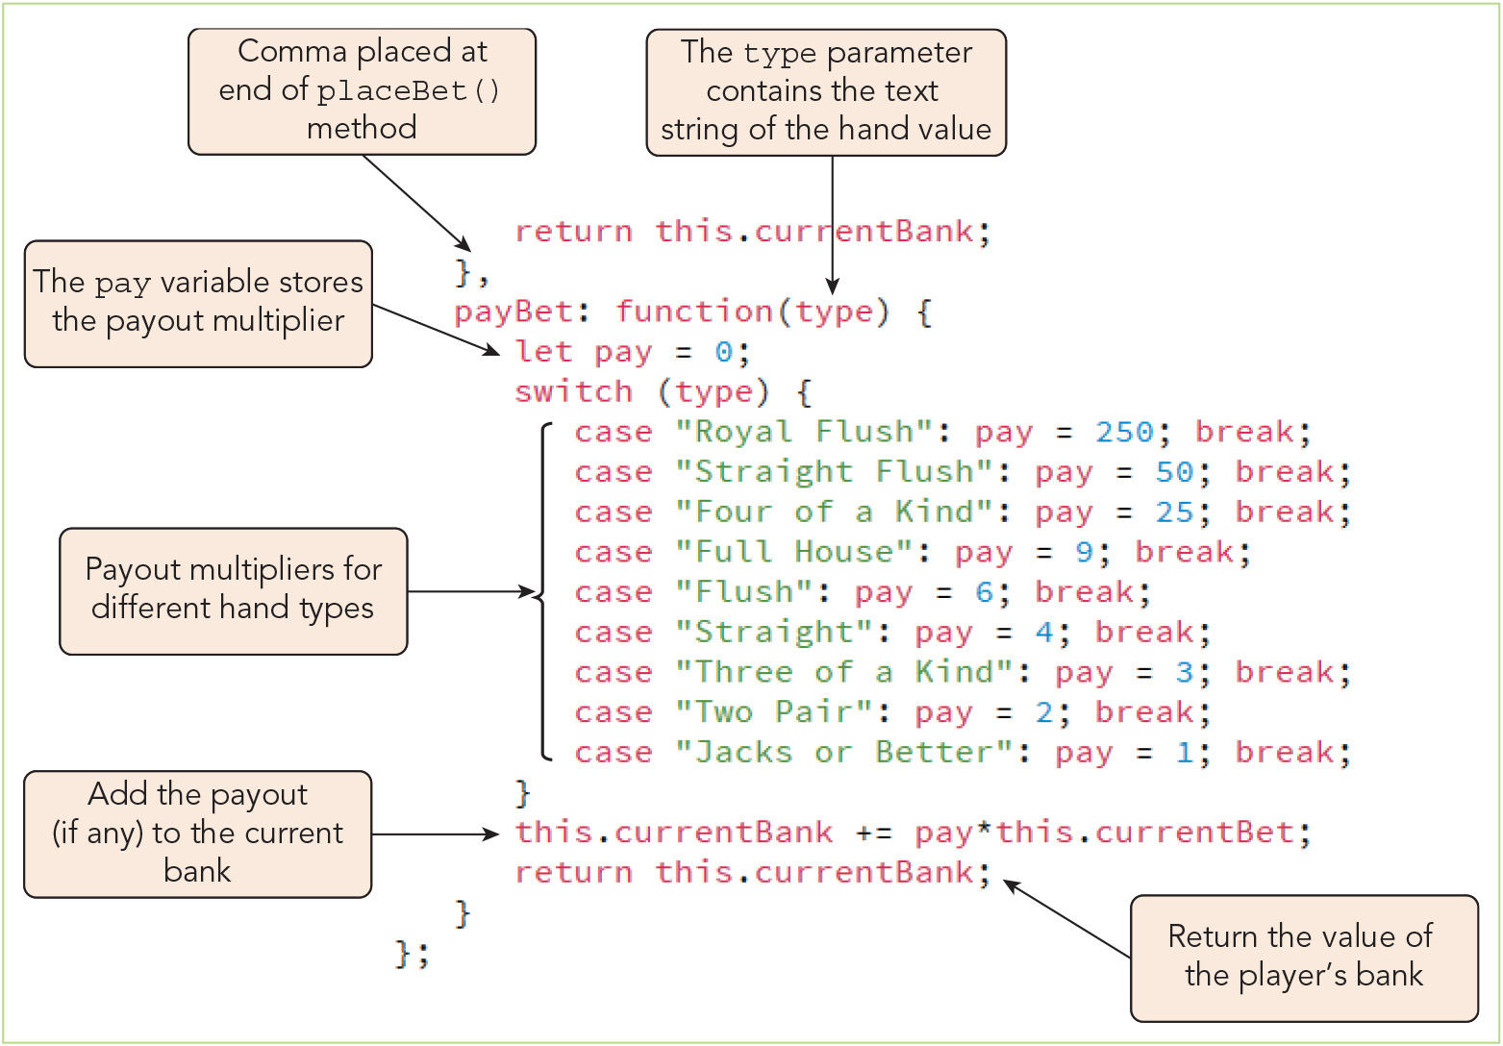
Working with Public, Private, and Privileged Methods (4 of 6)
Figure 8-29 Calculating the payout for a winning hand

Slide 42
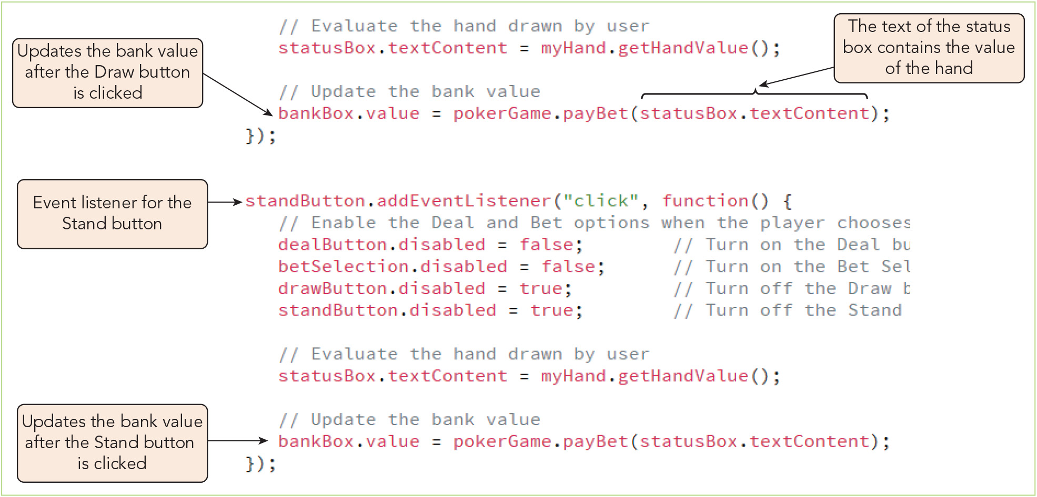
Working with Public, Private, and Privileged Methods (5 of 6)
Figure 8-30 Applying the payBet() method to update the player’s bank

Slide 43
Working with Public, Private, and Privileged Methods (6 of 6)
Guiding user choices with interface cues
Visual appearance of user interface elements can help users understand how to use an application
The poker game demonstrated some helpful visual cues:
Buttons that were not applicable were disabled and grayed out
Reducing user choices to legitimate ones reduces distraction and guides the user

Slide 44
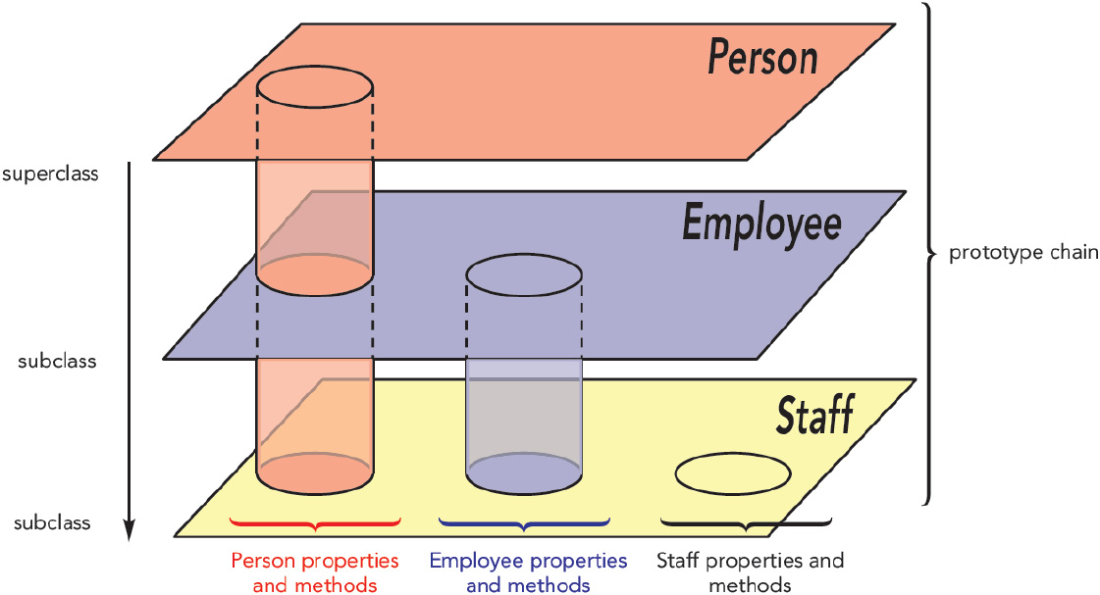
Combining Objects with Prototype Chains (1 of 7)
Figure 8-31 Prototypal inheritance

Slide 45
Combining Objects with Prototype Chains (2 of 7)
A prototype chain of objects ranges from a base object class, or superclass, down to the lower classes, or subclasses
Creating a prototype chain
Create object classes that include methods that build upon methods from a base class
Chain them together by defining the prototype of each class as an instance of a higher- order class
Once the chain is established, an instance off a subclass will inherit all properties and methods defined throughout the prototype chain above it

Slide 46
Combining Objects with Prototype Chains (3 of 7)
Creating a prototype chain (continued): sample prototype chain function Person(fName, lName) { this.firstName = fName; this.lastName = lName; this.name = function() { return this.firstName + "." + this.lastName; } } function Employee(fName, lName) { this.firstName = fName; this.lastName = lName; this.email = function() { return this.name() + "@example.com"; } }

Slide 47
Combining Objects with Prototype Chains (4 of 7)
Creating a prototype chain (continued): sample prototype chain (continued) function Staff(fName, lName) { this.firstName = fName; this.lastName = lName; this.title = null; this.id = function() { return this.email() + " [" + this.title + "]"; } } Staff.prototype = new Employee(); Employee.prototype = new Person(); let hire = new Staff("Keisha", "Adams"); hire.title = "Programmer"; console.log(hire.id()); // logs Keisha.Adams@example.com [Programmer]

Slide 48
Combining Objects with Prototype Chains (5 of 7)
Creating a prototype chain (continued)
When defining a prototype chain, begin with the lowest subclass and move up
The interpreter attempts to resolve a reference to a property or method in this order:
Check for the property or method within the current object instance
Check with the object's prototype
If the prototype is an instance of another object, check that other object
Continue moving up through the chain
Using the base object
Base object (Object): the fundamental JavaScript object whose properties and methods are shared by all native, host, and custom objects
Base object properties and methods can be used to explore and/or define a custom object's properties

Slide 49
Combining Objects with Prototype Chains (6 of 7)
Using the base object (continued)
To reference the prototype of an object instance, use the Object.getPrototypeOf() method and pass in the name of the object instance as the argument
The Object.create() method can be used to create objects based on an existing prototype, a reference to which is passed in, e.g.: let hire2 = Object.create(Staff.prototype);
Using the apply() and call() methods
Syntax for borrowing a method from one object class and calling it on objects of a different class using the apply() method: function.apply(thisObj [,argArray])
function is a reference to a function
thisObj is the object that receives the actions of the function
argArray is an optional array of argument values sent to the function

Slide 50
Combining Objects with Prototype Chains (7 of 7)
Using the apply() and call() methods (continued)
Syntax for sharing a method between object classes using the call() method: function.call(thisObj, args)
args is a comma-separated list of argument values for function
Note that the apply() method is used with arrays, whereas the call() method is used for a comma-separated list of values

Slide 51
Data Storage with Associative Arrays (1 of 6)
Associative array: a data structure that uses the object literal structure to store data as key: value pairs in which a key term is paired with a data value
General syntax for an associative array: let array = {key1:value1, key2:value2, …}
Not a true array; uses the bracket notation to reference an item by key rather than by index
The for in and for of loops
Syntax for iterating over an associative array: for (let prop in object) { commands }
All properties an object inherits from other objects will be included in the for in loop

Slide 52
Data Storage with Associative Arrays (2 of 6)
The for in and for of loops (continued)
Only properties that are enumerable (countable) are accessible to for in loops
Syntax for checking whether a property is enumerable: obj.propertyIsEnumerable(prop)
Syntax for iterating over an enumerable list such as an array, node list, or HTML collection using a for of loop: for (let items of list) { commands }
Storing object data in JSON
JavaScript Object Notation (JSON): a data interchange format similar in structure to JavaScript objects and used for storing structured data in a text-based format
Data interchange format: a text format that almost all systems have agreed upon as a common standard for information exchange

Slide 53
Data Storage with Associative Arrays (3 of 6)
Storing object data in JSON (continued): Sample JSON data: { "name" : "Keisha Adams", "age" : 27, "address" : { "street" : "41 Maple Avenue", "city" : "Ithaca", "state" : "New York", "postal code" : "14850" }, "phone" : [ { "type" : "work", "number" : "607-555-7812" }, ...

Slide 54
Data Storage with Associative Arrays (4 of 6)
Storing object data in JSON (continued)
JSON supports three data types:
Simple values such as numeric values, text strings, Boolean values, and null
Objects with contents written as key: value pairs
Arrays containing an array literal of simple values or objects
Syntax for converting a JSON text string to an object using the parse() method: let object = JSON.parse(JSONtxt)
Sample uses of the parse() method: employee["name"] // returns "Keisha Adams employee.age // returns 27 employee.address.city //returns "Ithaca" employee["phone"][1].type // returns "mobile"

Slide 55
Data Storage with Associative Arrays (5 of 6)
Storing object data in JSON (continued)
Syntax for converting a JavaScript object into the JSON format using the stringify() method: JSON.stringify(object, [replacer [, space]]);
replacer is an optional array of text strings and numeric values for filtering the object
space is an optional argument to insert spaces into the output string
Sample uses of the stringify() method: JSON.stringify(27) // returns '27' JSON.stringify(false) // returns 'false' JSON.stringify({name: "Keisha Adams", age: 27}) // returns '{"name":"Keisha Adams","age",27}' JSON.stringify(new Date(2024, 5, 4, 13, 15, 8)) // returns '2024-06-04T18:15:08.000Z'

Slide 56
Data Storage with Associative Arrays (6 of 6)
Storing object data in JSON (continued)
Sample expression that returns only the name property of an object: JSON.stringify({name: "Keisha Adams", age: 27}, ['name']) // returns '{"name":"Keisha Adams"}'
Catching syntax errors in JSON data
Key names must be enclosed within double quotes
Collection of key: value pairs must be placed in a comma-separated list
All nested objects must include opening and closing braces
Data must be either enclosed within single quotes (on one line) or entered as a template literal (for multi-line data)

Slide 57
Activity 8.2: Think, Pair, and Share
Form pairs/groups of two to four class members.
Your group will practice working with data structures by transforming an object into JSON data and then back into an object. First, work together to write code creating a simple pie object with properties representing flavor, number of slices, and whether or not everyone in your group likes this kind of pie.
Use the stringify() method to convert the pie object into a JSON data structure and save it to a variable. Verify that the JSON data returned correctly preserves the data stored in your original object.
Now use the parse() method to convert the JSON-formatted data back into a JavaScript object. Test your recreated object to verify that it behaves as expected.
Notes:
Instructions:
Use the Think, Pair, Share activity to encourage students to solve problems collaboratively and to apply the real-world skill of evaluating, modifying, and debugging code created by another programmer.

Slide 58
Activity 8.3: Discussion Questions
Why is JavaScript known as an object-oriented programming language, and what are the implications of this language characteristic?
What is a JavaScript associative array, and how does it compare to a JSON data structure?
Notes:
Instructions:
Use the Discussion activity to encourage group conversation about a related topic of interest.

Slide 59
Self-Assessment
How do you feel about the OOP approach as it is applied by the JavaScript language and its conventions? If you have written object-oriented programs in other programming languages, how does the way OOP is practiced in JavaScript compare?
When do you think it is necessary or desirable to rely on closures to achieve functionality in a program? When you studied the examples of closures in Chapter 8, did you think of any alternative ways to accomplish the same tasks that would avoid closures?
What experience do you have with the JSON data interchange format? To what extent do you anticipate working with JSON in your future career?
Notes:
Instructions:
Use the Self-Assessment question to encourage students to evaluate their progress or goals in the course, as well as determine how they might apply their learning or grow as an individual.

Slide 60
Summary
Now that the lesson has ended, you should have learned to:
Describe the fundamentals of object-oriented programming.
Create an object literal.
Define a method for a customized object.
Apply a method to an object class using a prototype.
Create and apply a closure.
Work with public, private, and privileged methods.
Create a prototype chain to combine objects.
Work with associative arrays to store data in JSON format.
Notes:
Instructions: Reiterate the learning objectives for the lesson. Students should use this information to guide their studies and reinforcement of new concepts.

